Slide 1

ສະມາຊິກຂອງທີມ
ຈາກ 2cs1
ທ້າວ ສຸລະໄຊ ໄຊຍະສອນ
ນາງ ສີດາວອນ ຈັນທາ
ທ້າວ ສຸກສະຫວັນ ແກ້ວສຸພາພອນ
ນາງ ປັດທະມາ ອິນທະລັງສີ
ນາງ ແອນດີ່ ຈັນທະວົງ

Slide 2
ສາມາດຕິດຕໍ່ຫຼືສອບຖາມກ່ຽວກັບ Project ໄດ້ທີ່
+ ທ້າວ ສຸລະໄຊ ໄຊຍະສອນ ເບີ: 02098556454

Slide 3
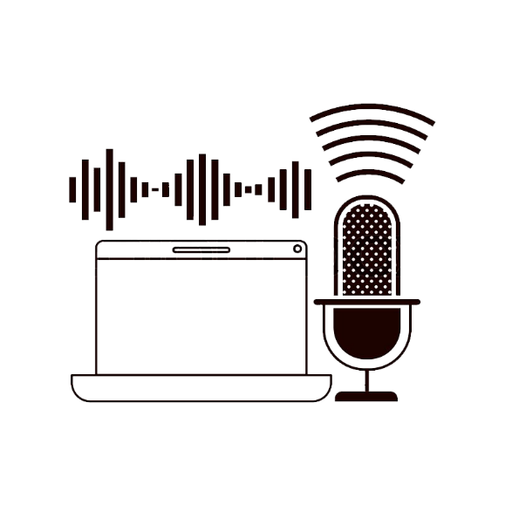
TATAR ASSISTANT

Slide 4
1
OUTLINE
What is Tatar Assistant
2
ແນວຄວາມຄິດໃນການເຮັດ ເແລະ ເປົ້າໝາຍຂອງການເຮັດ Project
3
ຂັ້ນຕອນການເຮັດວຽກຂອງ System
4
ເຄື່ອງມືທີ່ຕ້ອງໃຊ້ໃນການ Run ແລະ ໃຊ້ງານ System
5
ອະທິບາຍ Source Code
6
ຈຸດດີແລະຈຸດອ່ອນຂອງ System
7
ສິ່ງທີ່ສາມາດນຳໄປຕໍ່ຍອດ
8
Demonstration

Slide 5
What is Tatar Assistant
1
1

Slide 6
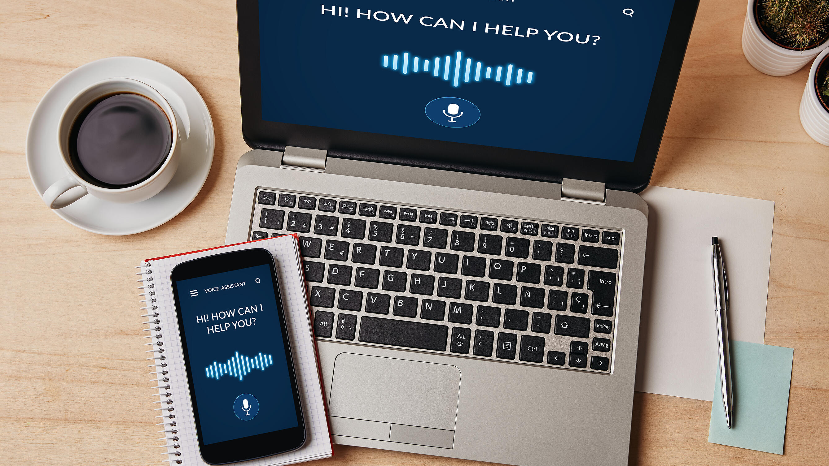
2

Slide 7
2
ແລະ
ແນວຄວາມຄິດໃນການເຮັດ
ເປົ້າໝາຍຂອງການເຮັດ Project
3

Slide 8

ແນວຄວາມຄິດໃນການເຮັດ Project
4

Slide 9
ເປົ້າໝາຍຂອງການເຮັດ Project
5

Slide 10

3
ຂັ້ນຕອນການເຮັດວຽກຂອງ System
6

Slide 11

ຂັ້ນຕອນການເຮັດວຽກຂອງ Program
7

Slide 12
4
ເຄື່ອງມືທີ່ຕ້ອງໃຊ້ໃນການ
Run ແລະໃຊ້ງານ System
8

Slide 13
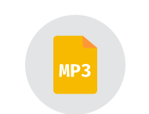


ເຄື່ອງມືທີ່ຕ້ອງມີເພື່ອໃຊ້ໃນການ Run ແລະ ໃຊ້ງານ System
9

Slide 14
ອະທິບາຍ Source code
5
10

Slide 15
ອະທິບາຍ Source code
import speech_recognition as sr
from time import ctime
import time
import os
from gtts import gTTS
library
def speak(audioString):
print(audioString)
tts = gTTS(text=audioString, lang='en')
tts.save("audio.mp3")
os.system("mpg123 audio.mp3")
11

Slide 16
ອະທິບາຍ Source code(ຕໍ່)
if "ส่องสาว" in data:
data = data.split(" ")
speak("She is so cutest")
os.system("start https://web.facebook.com/tatar.souvannasing")
Say something!
You said: ส่องสาว
She is so cutest
High Performance MPEG 1.0/2.0/2.5 Audio Player for Layers 1, 2 and 3
version 1.25.13; written and copyright by Michael Hipp and others
free software (LGPL) without any warranty but with best wishes
Playing MPEG stream 1 of 1: audio.mp3 ...
MPEG 2.0 L III cbr32 24000 mono
[0:01] Decoding of audio.mp3 finished.
Say something!
Output
12

Slide 17
ອະທິບາຍ Source code(ຕໍ່)
except sr.UnknownValueError:
speak("Google Speech Recognition could not understand audio")
except sr.RequestError as e:
print("Could not request results from Google Speech Recognition service; {0}".format(e))
Output
Google Speech Recognition could not understand audio
High Performance MPEG 1.0/2.0/2.5 Audio Player for Layers 1, 2 and 3
version 1.25.13; written and copyright by Michael Hipp and others
free software (LGPL) without any warranty but with best wishes
Playing MPEG stream 1 of 1: audio.mp3 ...
MPEG 2.0 L III cbr32 24000 mono
[0:03] Decoding of audio.mp3 finished.
Say something!
13

Slide 18
ອະທິບາຍ Source code(ຕໍ່)
time.sleep(2)
speak("Hello boss can I help you?")
while 1:
data = recordAudio()
dekdoydev(data)
Hello boss can I help you?
High Performance MPEG 1.0/2.0/2.5 Audio Player for Layers 1, 2 and 3
version 1.25.13; written and copyright by Michael Hipp and others
free software (LGPL) without any warranty but with best wishes
Playing MPEG stream 1 of 1: audio.mp3 ...
MPEG 2.0 L III cbr32 24000 mono
[0:01] Decoding of audio.mp3 finished.
Say something!
Output
14

Slide 19
6
ຈຸດດີແລະຈຸດອ່ອນຂອງ System
15

Slide 20
ຈຸດດີ
16

Slide 21

ຈຸດອ່ອນ
17

Slide 22
7
ສິ່ງທີ່ສາມາດນຳໄປຕໍ່ຍອດ
18

Slide 23
ສິ່ງທີ່ສາມາດນຳໄປຕໍ່ຍອດ
19

Slide 24
Demonstration
8
20

Slide 25
Q&A

Slide 26
Thank you

